Slide 1
Face Recognition using PCA
Aditya Mulampally

Slide 2
Summary of PCA
Principle Component Analysis or PCA is a technique where it provides compact data representation.
With PCA we can reduce the number of dimensions present in the data, and construct a lower dimension linear subspace that best explains the variation of the data from the mean.
We can use this to find the most optimal projection that best represents the data.

Slide 3
PCA steps
The general steps to be followed are as follows:
Obtain all the images and represent them in the form of a vector.
We compute the average face and then subtract it from every face present.
We then compute the covariance matrix.
We need to find the largest eigenvalues for the optimal projection, I have chosen the top 20 values to work with.
The accuracy is determined by the ratio between the sum of the top largest top eigenvalues to all of the values.

Slide 4
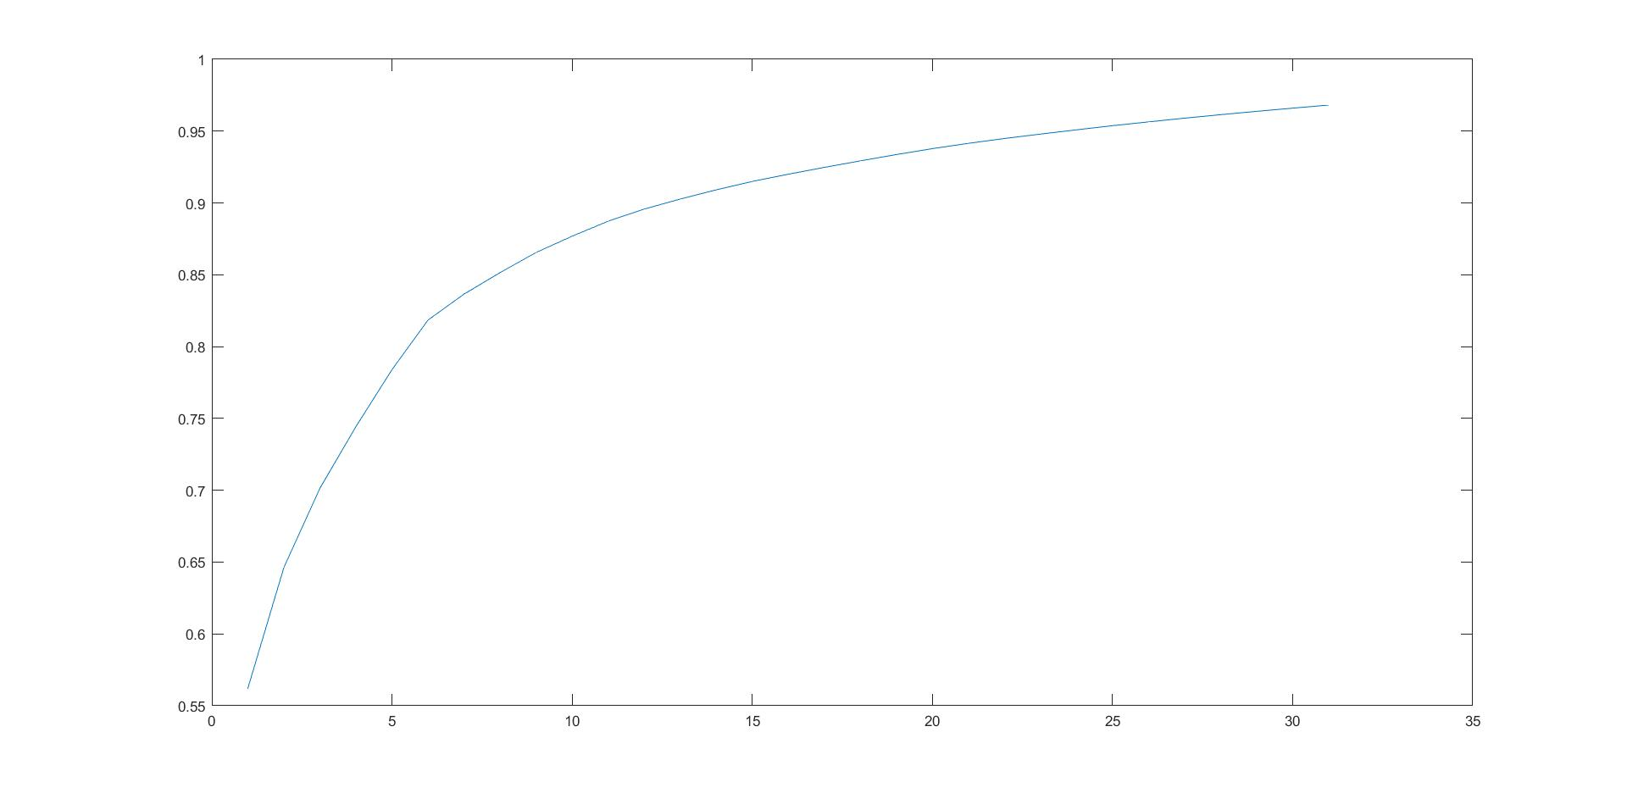
Graph to find ‘p’
As seen from the graph I have chosen a value of p=20 as it had a percentage of 93.8

Slide 5
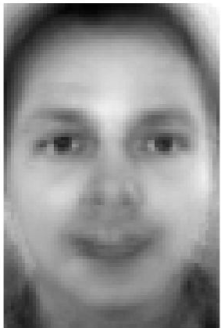
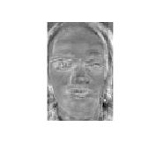
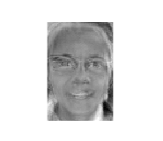
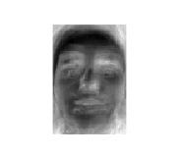
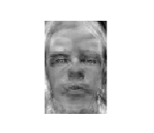
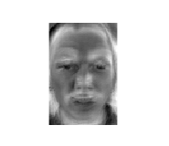
Mean face and ‘p’ eigen faces
Mean Face
A few of the top eigen faces are shown here.
All the faces are also in the folder of the project folder submitted

Slide 6

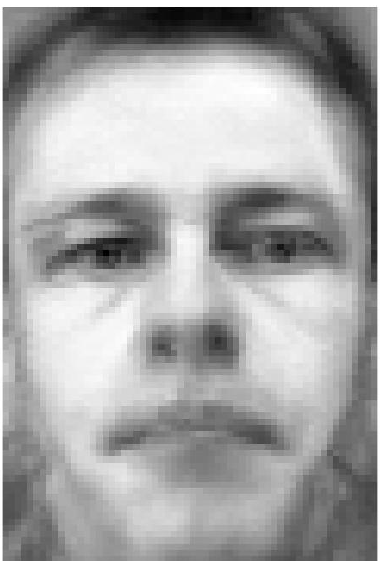
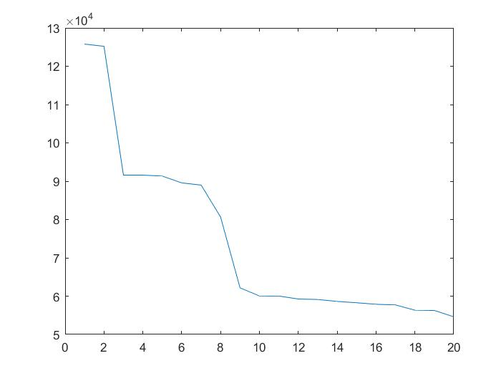
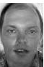
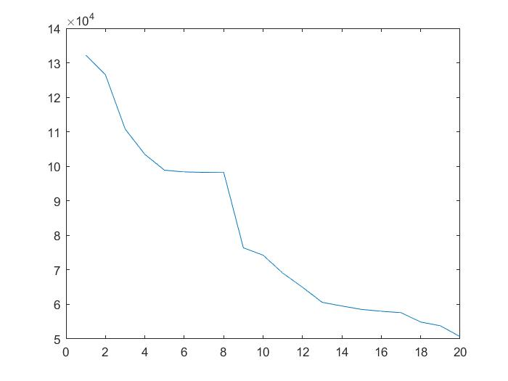


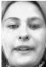
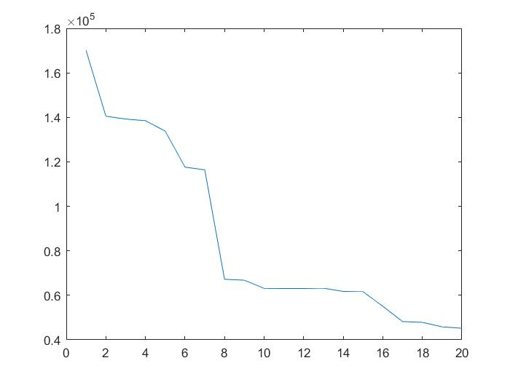

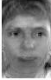
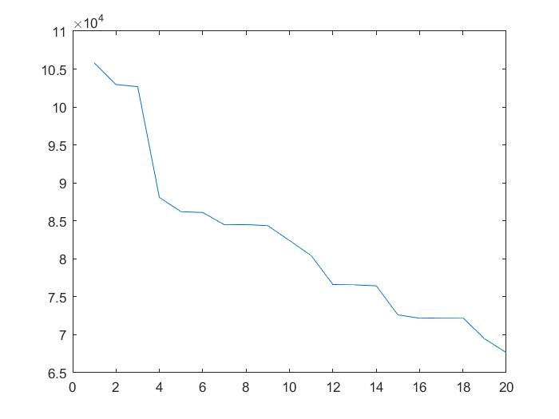
PCA Reconstruction Results
ORIGINAL
RECONSTRUCTED
Error Value for each ‘p’
ORIGINAL
RECONSTRUCTED
Error Value for each ‘p’

Slide 7

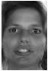
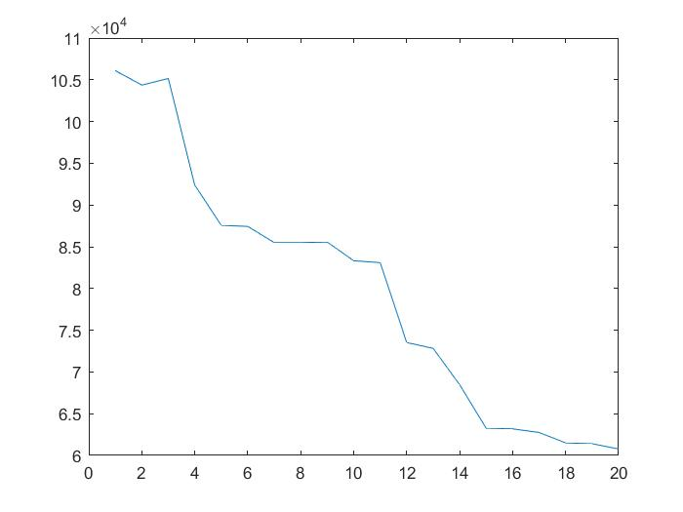

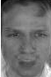
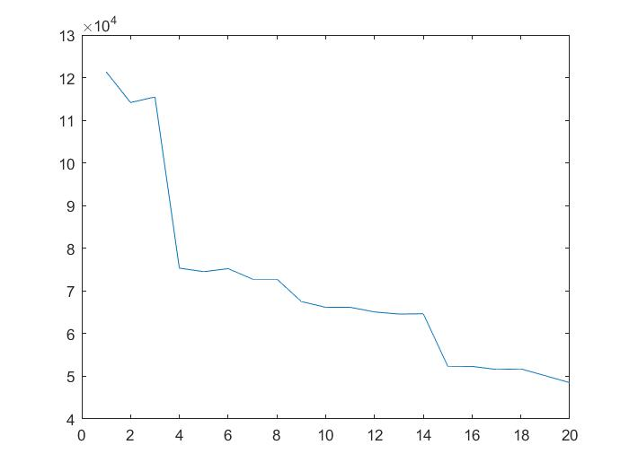

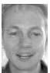
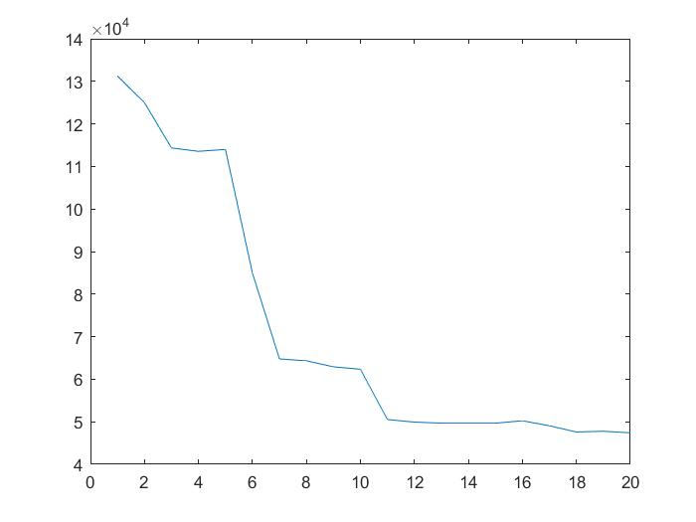
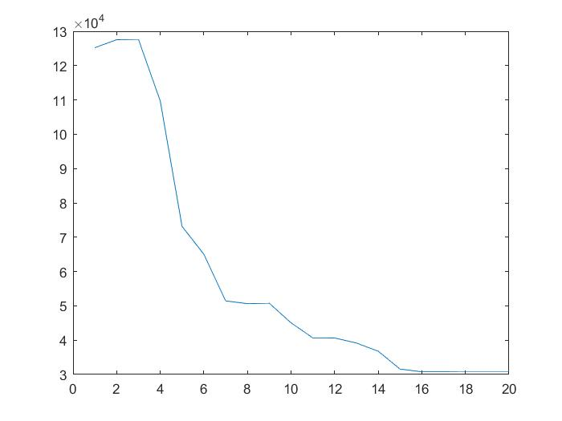

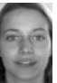
PCA Reconstruction Results
ORIGINAL
RECONSTRUCTED
Error Value for each ‘p’
ORIGINAL
RECONSTRUCTED
Error Value for each ‘p’

Slide 8

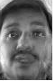
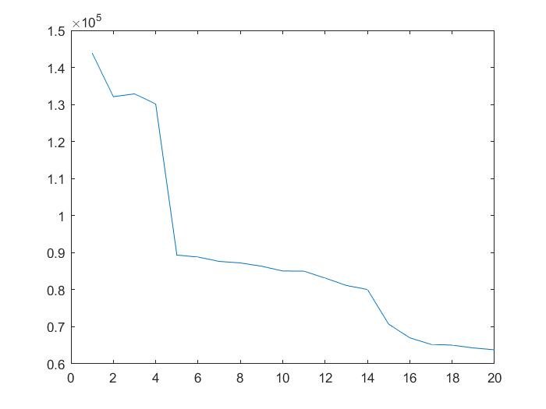

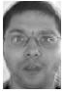
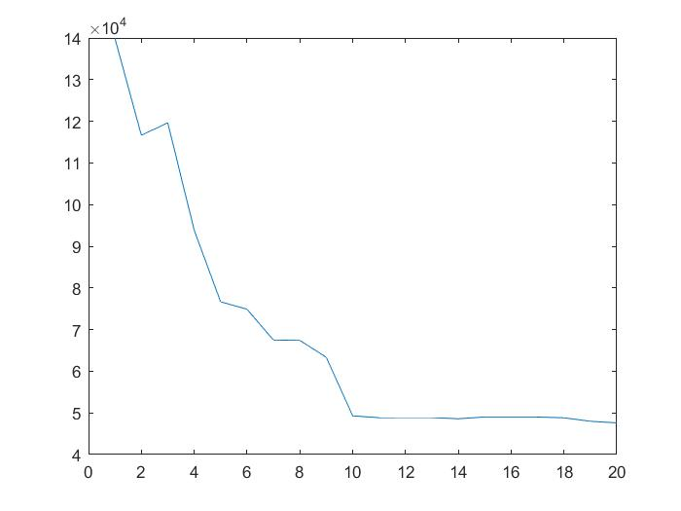

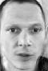
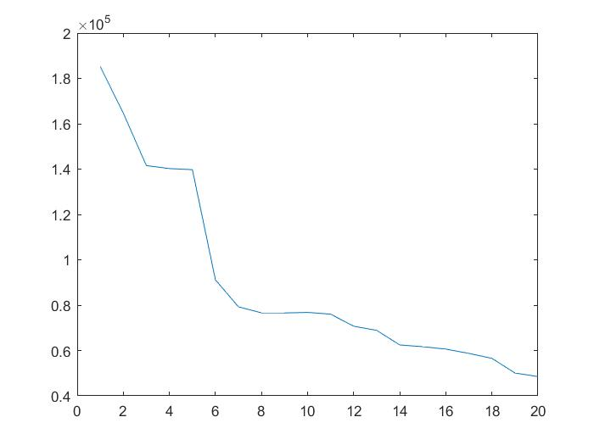

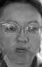
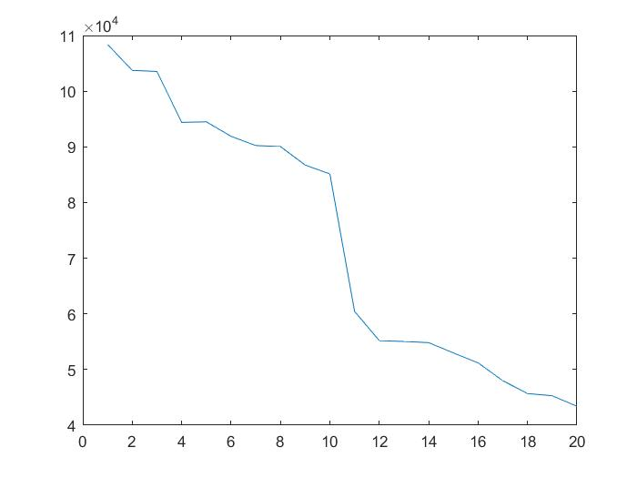
PCA Reconstruction Results
ORIGINAL
RECONSTRUCTED
Error Value for each ‘p’
ORIGINAL
RECONSTRUCTED
Error Value for each ‘p’

Slide 9
PCA Reconstruction Observations
The number of the bullet point is equal to the discussion of the person number:
For this person there is some blurring around the lips area but overall it is good.
The second persons reconstruction is quite good.
There is some blurring on the overall image, but the reconstruction is good.
This is one of the poorly reconstructed images, I think due to the variation in eye positions, is the cause of this.
This persons reconstruction is quite good.
This person also has problems of reconstruction on the lip area.
This persons reconstruction is quite good.
This persons reconstruction is quite good.
This person also has poor reconstruction results but I think if the image was brighter it would have given better results.
The glasses from this persons face is missing form this reconstruction, I think we need more people in the data set with spectacles for better results.
There is some over all blurring of the image, but the result can be identified.
The spectacles on this person are better reconstructed, but still the result is poor.

Slide 10
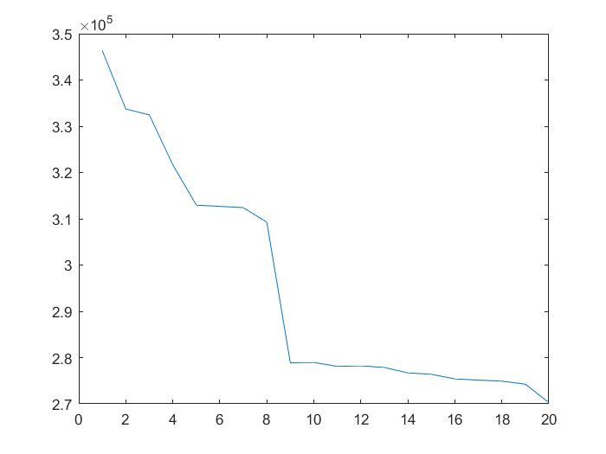
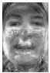
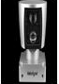
Unknown Image Reconstruction
Here I attempted to reconstruct an image of a LIDAR sensor.
The second image is the result of the reconstruction where it can be seen that the process did a very poor job.
It can be seen that there is a faint halo of the sensors plain surface on the middle of the output image.
The error of the reconstruction is - 270272.351894422

Slide 11
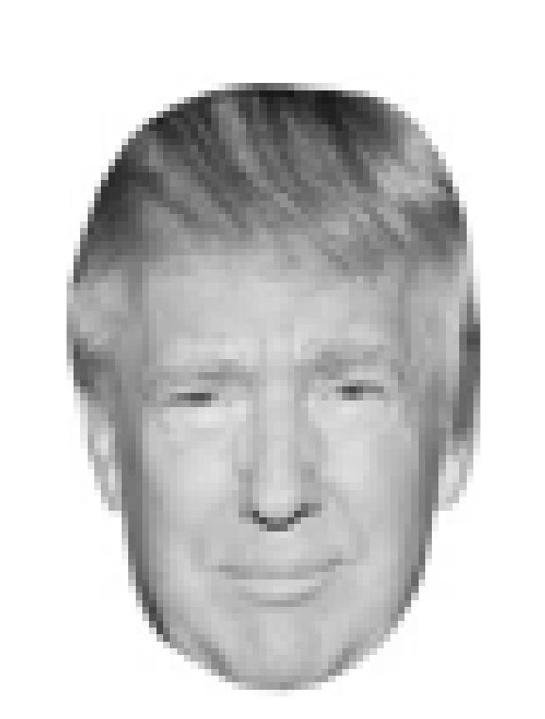
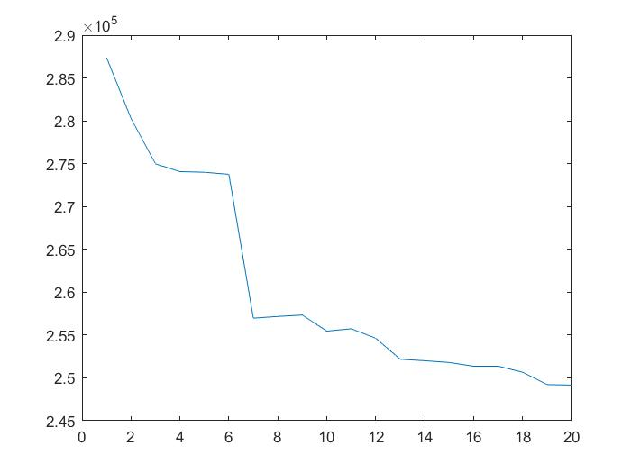
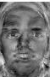
Unknown Face Reconstruction
I have attempted to reconstruct the face of President Trump.
As seen from the second image which is the result, the reconstruction is no where close to the original.
Here might be the possible reasons:
the eye structure does not match with the training data
Ears are visible clearly, where in the data set there are no ears visible.
But the error is still 249162.388110866, lower than that of the unknown image so this can still pass as a face.

Slide 12
Overall Accuracy
Due to the way I wrote my program, it would become very hard to compute the accuracy percentage with different values of p, hence I have the results only at my original value of p = 20
When I use top 3 ranks, I get an accuracy of 98.33%
When I use top 2 ranks, I get 96.66%
When I use only the top most rank, I get 93.33% accuracy.

Slide 13
Summary
I saw that with the usage of more eigenvectors, the results improved with each inclusion of the vector.
And for the unknown face detection I learned that the pose in the training data is very important, which leads effects the results.
From this project I have attained a great appreciation to the facial recognition technologies present in our phones, computers etc. where they can perform detection on the fly.

